Slide 1
Financing Dual Enrollment: Innovative State Strategies
2:30 – 4 p.m.
Room: Maryland

Slide 5
Clarification of terms
Dual enrollment: College courses offered to high school students for (typically) both high school and college credit, regardless of course location, instructor or modality
Dual credit (KY specific): See dual enrollment

Slide 6
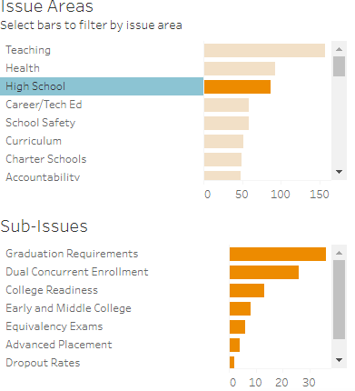
Dual Enrollment continues to be a hot topic!

Slide 7
Trend: Greater state investment in DE
Drivers: Greater awareness of DE as strategy to increase postsecondary
Particularly among students underrepresented
in higher ed.
Readiness
Matriculation
Completion

Slide 8
Who pays dual enrollment tuition?
In 2016:
Local decision:
13 states + D.C.
District: Four states
State pays some tuition
State pays all tuition

Slide 9
Tradeoffs of who pays…
Local decision:
Local flexibility
☹ Potential for access disparities across state
District:
In theory, PSI may translate reduced financial burden into providing other services
☹ Potential for access disparities across state

Slide 10
Tradeoffs of who pays tuition…
State pays some:
More $ to go around to more students, for more courses
☹ Can students/parents make up the difference?
State pays all:
Eliminates potential district-district or student-student
access disparities
☹ Only so many $ to go around!

Slide 11
Overview of today’s session
Focus on Georgia and Kentucky
Basics on policy and policy adoption
Policy implementation
Facilitated small group discussion
Other things states need to think about…

Slide 12

Your Education Policy Team.

Slide 13
Download session resources:
bit.ly/ecsnf18resources

