Slide 1
Friday, December 6, 2019
OFFICE OF THE
Deputy Superintendent
Hawaiʻi Dept. of Education
Hawaiʻi Teacher Standards Board
ECS Winter Commissioners Meeting
Phyllis Unebasami
HIDOE Deputy Superintendent
Lynn Hammonds
HTSB Executive Director

Slide 2
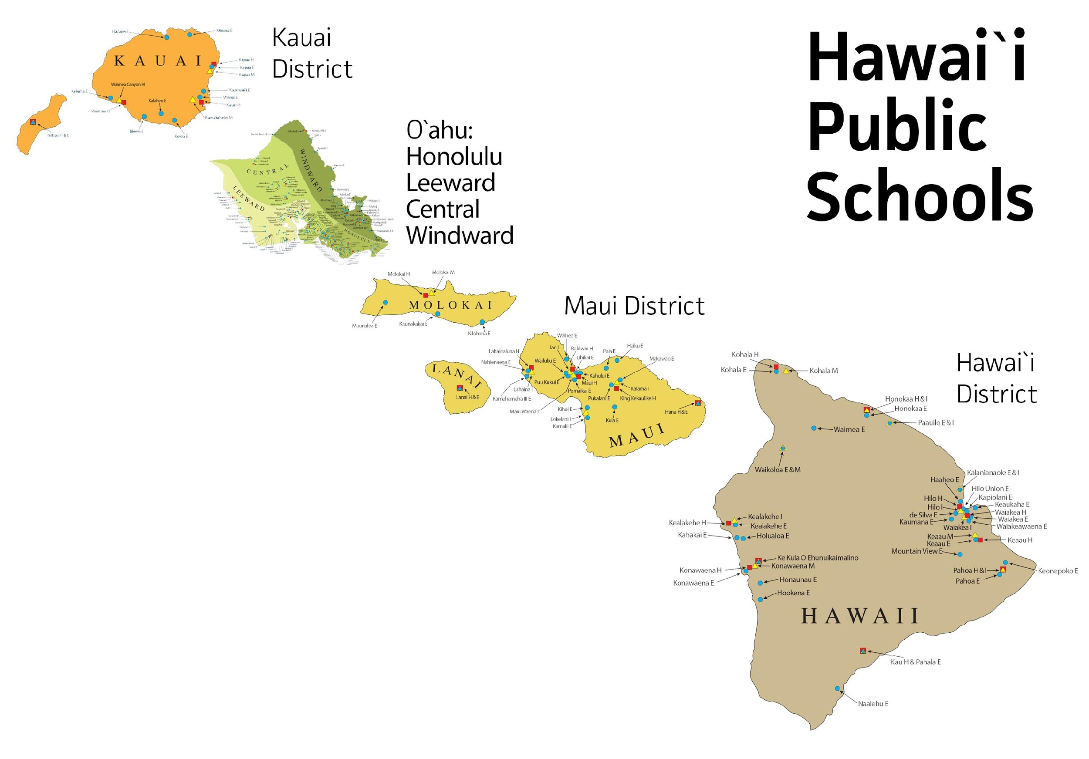
OFFICE OF THE
Deputy Superintendent
Hawaiʻi Department of Education
293 Schools
256 HIDOE, 37 charter
174 elem, 41 mid, 34 high, 44 mix
55 military-impacted schools
20 schools offer Pre-K
15 Complex Areas
A high school & its feeder schools. Complex Areas: regional groupings of 2 to 4 complexes
1 District
Only Local Educational Agency (LEA) and State Educational Agency (SEA) in the nation.
180,000 Students
We serve ALL of Hawaiʻi’s children, with a diversity of socioeconomic, cultural & developmental backgrounds.
12,700 Teachers
Including classroom and non-classroom teachers, such as librarians & counselors.

Slide 3
OFFICE OF THE
Deputy Superintendent
Hawaiʻi Teacher Standards Board
Approval of educator preparation programs.
Issues/renews licenses & permits.
Professional development to support standards.
Holds disciplinary hearings & establishes penalties for teacher misconduct.

Slide 4
Hawaiʻi’s Licensure Reciprocity
Mandated in statute
Detailed in administrative rules
Carried out in policies
Covers:
Programs
Licenses
Experience
All other US states, inhabited territories, non-US countries

Slide 5
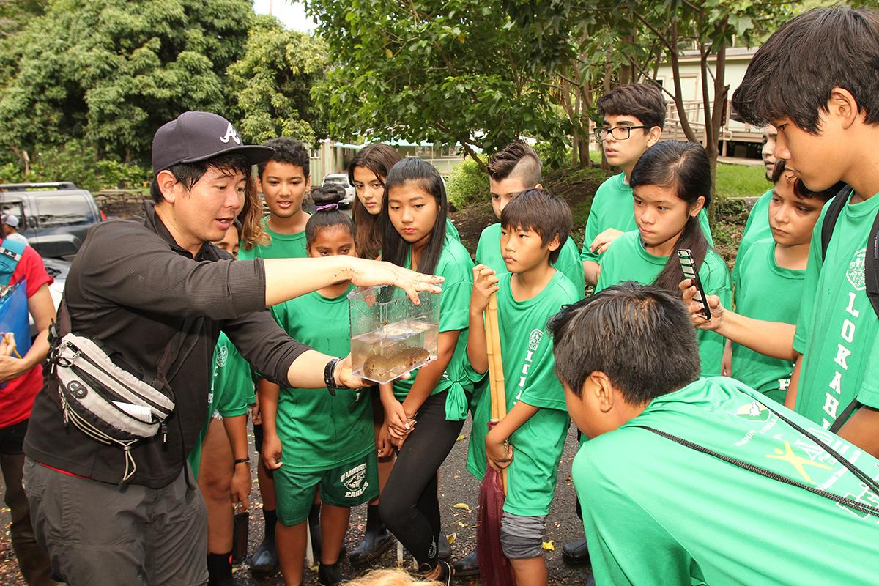
“Only In Hawaiʻi”
Indigenous & Culturally Focused Teacher Preparation Programs
International review process
Hawaiian immersion permit

Slide 6
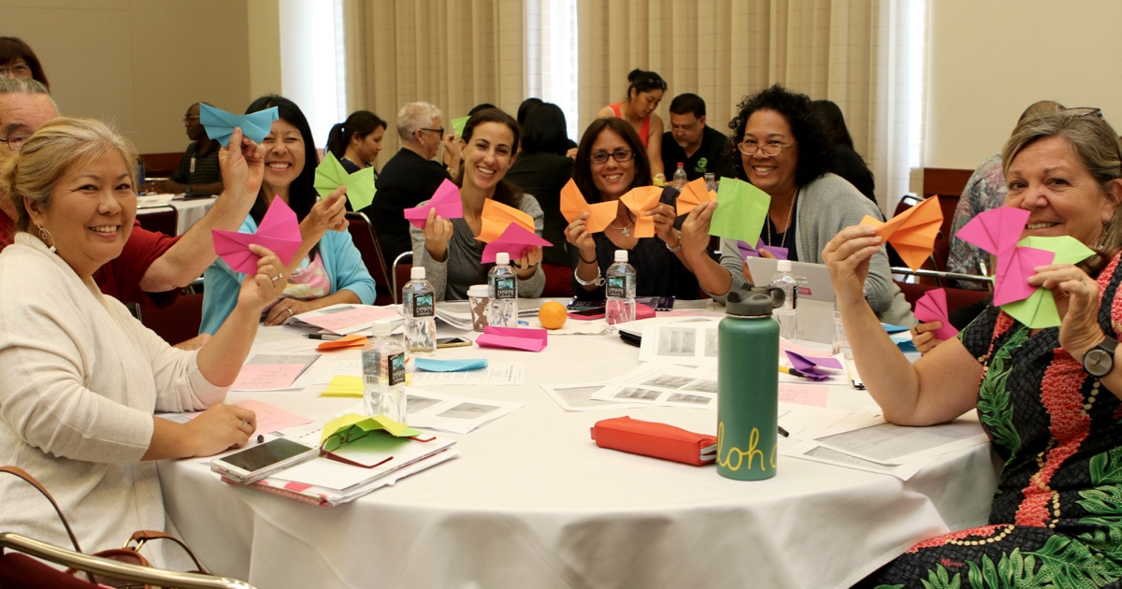
Hawaiʻi’s 5-Year Strategic Plan
Improving teacher recruitment & retention through coordinated partnerships
Teacher Education Coordinating Committee Advisory group of HIDOE, HTSB, universities & colleges, adult education, & Hawaiian language programs.
Troops to Teachers
Federally-funded program helps members of the armed forces transition from military careers to education as K-12 teachers.
Microcredentialing
Establishing digital certification process showing mastery in teaching skill sets.
Teacher Mentoring
Teacher Induction Center 3-year induction program for novice teachers. Includes working w/a highly skilled, trained mentor to accelerate teaching effectiveness within strong support system.
Grow Our Own
State-funded tuition stipends for post-degree teaching certificates with flexible online courses in return for three-year teaching commitment.

Slide 7
Questions?
Mahalo!
Phyllis Unebasami
Deputy Superintendent
Hawaiʻi State Dept. of Education
Phyllis.Unebasami@k12.hi.us
Lynn Hammonds
Executive Director
Hawaiʻi Teacher Standards Board
Lynn.Hammonds@hawaii.gov

