Slide 1
TOYs 2018 Meeting
Micah Wixom and Louisa Diffey
Wednesday, June 27, 2018

Slide 4
Notes:
RRCC
We are your education policy Team

Slide 5
350 Commissioners Across the Country:
Governors
Chief State School Officers
Chairs of Senate Education Committees Chairs of House Education Committees
Higher Education Executives
Policy Leaders

Slide 7
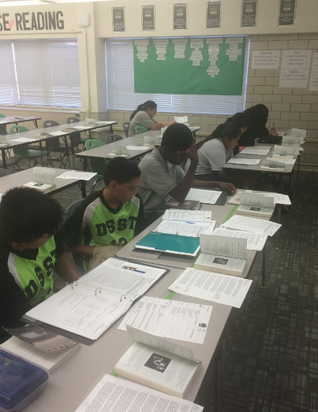
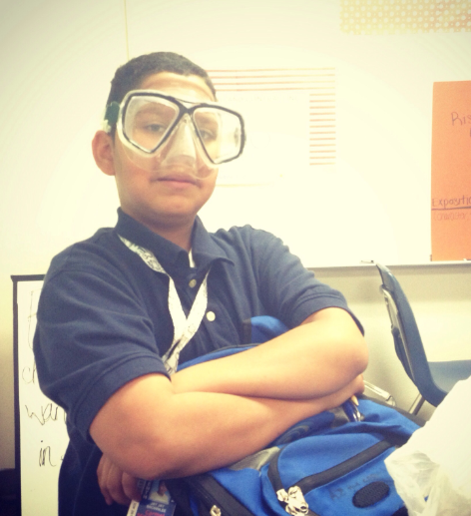
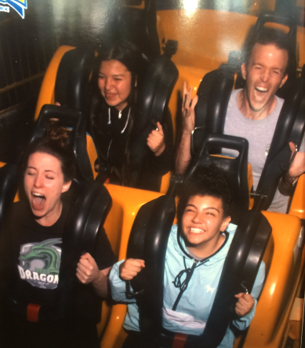

Slide 8
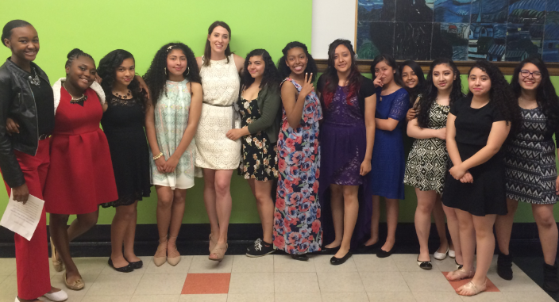

Slide 9
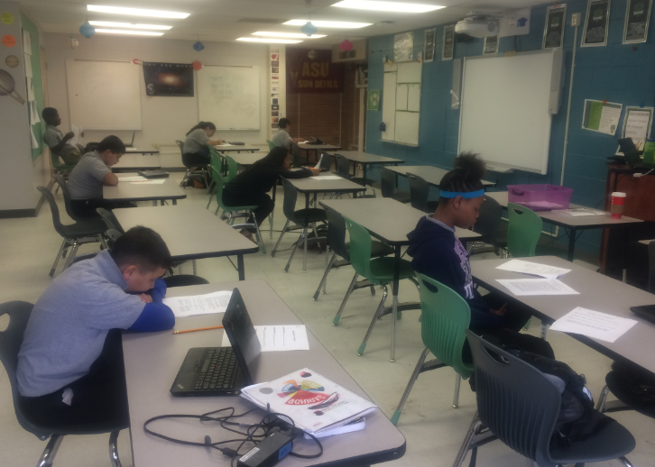

Slide 10
Education Policy National Overview

Slide 11
require full-day kindergarten.
13 states
plus D.C.
Notes:
North Carolina requires full-day kindergarten
Thirteen states plus Washington, D.C
Kindergarten Entrance Assessment was legislated in 2015-16 and includes social emotional learning. The results are also included in the state longitudinal data system.
Sources: http://ecs.force.com/mbdata/mbstprofexcL?Rep=KQST&st=North%20Carolina and https://www.ecs.org/wp-content/uploads/50-State-Comparison-K-3-Quality_Updated-1.pdf

Slide 12
Student Demographics
Enrollment growth and decline varies by region and state.
2014-15 (actual): 50.3 million (50,313,000)
2018-19 (projected): 50.8 million (50,759,000)

Slide 13
Student Race/Ethnicity 2014-15: - White: 49.5% - Black: 15.5% - Hispanic: 25.4% - Asian/Pacific Islander: 5.3% - American Indian/Alaska Native: 1.0% - Two+ races: 3.2%
Percentage of Schools by Poverty Levels
2014-15:
- Low-poverty (25% or less eligible for FRPL): 20%
- Mid-low poverty: 27%
- Mid-high poverty: 26%
- High-poverty (75% or more eligible for FRPL): 24%

Slide 14
3.1 million students estimated to be in charter schools.
States with highest percentages of students enrolled in charter schools (10% or more) :
Arizona
Colorado
District of Columbia
Delaware
Florida
Louisiana
Michigan
Utah

Slide 15
NAEP 4th and 8th Grade Proficiency 2017
4th Grade:
39% Math
35% Reading
37% Science
27% Writing
8th Grade: 32% Math
33% Reading
33% Science
31% Writing
Notes:
Source: The Nation’s Report Card

Slide 16
Teachers Leaving Profession 2011-12 to 2012-13
7.7%
Notes:
The percentage of North Carolina teachers who left the profession between the 2011-12 and 2012-13 school years was 5.5%.
The percentage of teachers who left the profession nationwide between the 2011-12 and 2012-13 school years was 7.7%.
Source: Schools and Staffing Survey (SASS) by the National Center for Education Statistics which was most recently administered in 2011-2012 (with a follow up questionnaire given in 2012-2013).

Slide 17
provide differential pay for high-need schools.
23 states
Notes:
North Carolina incentivizes teaching in high-need schools and subject areas through differential pay and loan forgiveness
North Carolina is one of 23 states that provide differential pay for high-need schools … Sources: NC SB 257 (2017); North Carolina 2016-17 Salary Manual ; National Council on Teacher Quality 2017 Compensation Policy

Slide 18
provide differential pay for shortage subject areas.
15 states
Notes:
… and one of 15 states that provide differential pay for shortage subject areas.
Sources: NC SB 257 (2017); North Carolina 2016-17 Salary Manual ; National Council on Teacher Quality 2017 Compensation Policy

Slide 19
provide loan forgiveness for high-need schools.
10 states
7 states
provide loan forgiveness for shortage subject areas.
Notes:
North Carolina is one of 7 states that provides loan forgiveness for high-need schools …
Sources: NC SB 257 (2017); North Carolina 2016-17 Salary Manual ; National Council on Teacher Quality 2017 Compensation Policy

Slide 20
Average Teacher Salary 2015-16
$58,353
Notes:
2015-2016 teacher salary
North Carolina $47,941
United States $58,353
2015-2016 teacher salaries (adjusted by the Comparable Wage Index)
NC: $45,461
US: $58,353
Source: The NCES CWI has not been updated since 2005. However, Dr. Lori Taylor at Texas A & M has updated the NCES CWI through 2013 using her original methodology. You can find her adjustments as well as a CWI based on the 2012-2014 American Community Survey here. Mike Griffith has also applied the CWI to each state’s teacher pay year by year.
Source: National Education Association’s “Rankings & Estimates: Rankings of the States 2016 and Estimates of School Statistics 2017.”

Slide 21
ME
37
WA
VT
MT
ND
NH
MA
OR
MN
NY
ID
WI
RI
SD
MI
CT
WY
PA
MD
NJ
IA
OH
DE
NE
IL
IN
WV
NV
VA
Washington D.C.
CA
UT
CO
KY
KS
MO
NC
TN
SC
STATES
OK
AR
AZ
NM
GA
AK
MS
AL
TX
LA
FL
HI
require candidates to hold a master’s degree and have at least three years of teaching or related experience to qualify for an initial school leader certification.
Notes:
AL AK AZ AR CT DE
HI ID IL IA KS KY
LA ME MD MN MS MT
NV NH NJ NM NY NC
ND OR PA RI SC SD
TN UT VT VA WA WV
WI

Slide 22
4-Year Public High School Graduation Rate 2015-16
84%
Notes:
In the 2015-2016 school year, 86% of North Carolina public high school students graduated high school within 4 years of starting 9th grade.
In the 2015-2016 school year, 84% of U.S. public high school students graduated high school within 4 years of starting 9th grade.
Source: NCES.

Slide 23
Contact ECS with questions
Micah Wixom
Mwixom@ecs.org
303-299-3673
Louisa Diffey
Ldiffey@ecs.org
303-299-3655

