Slide 1
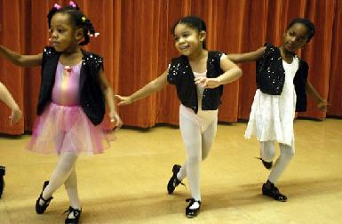
Illinois and Arts Learning:
A Case Study
Resource Slides
National Forum on Education Policy
Education Commission of the States
June 27-29, 2018
Dr. Jason Helfer,
Illinois State Board of Education
Jonathan VanderBrug,
Arts Alliance Illinois

Slide 2
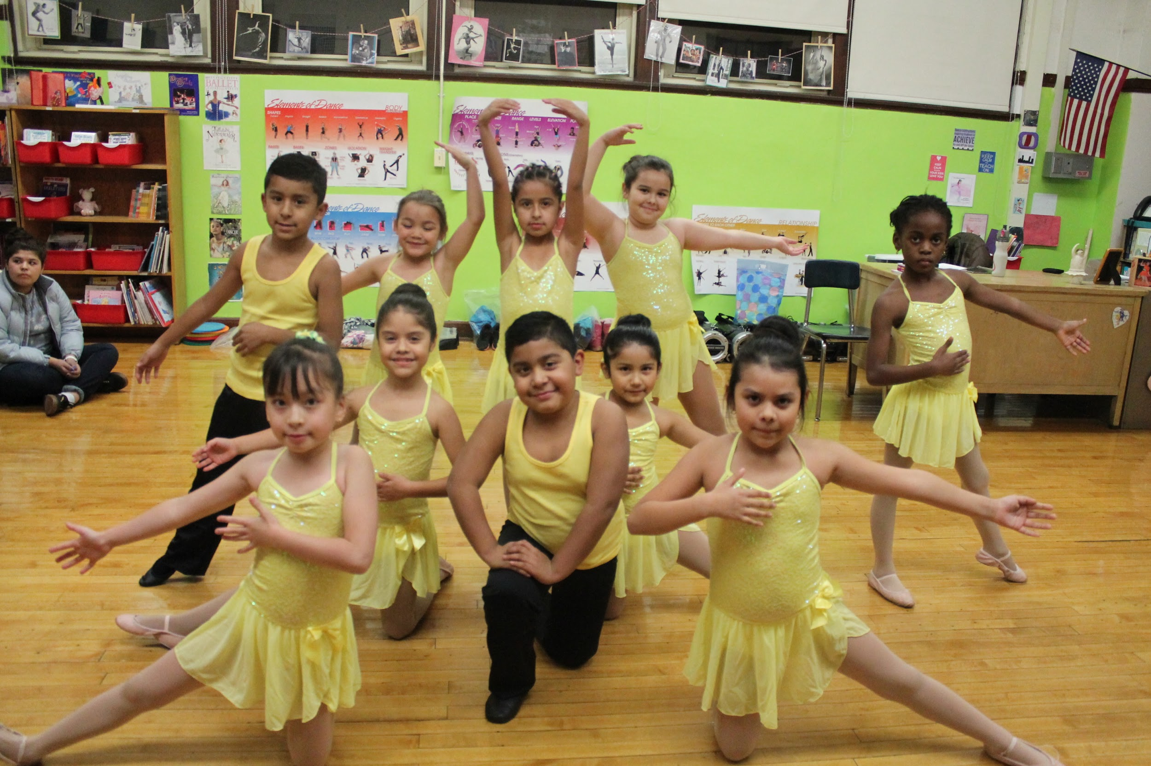
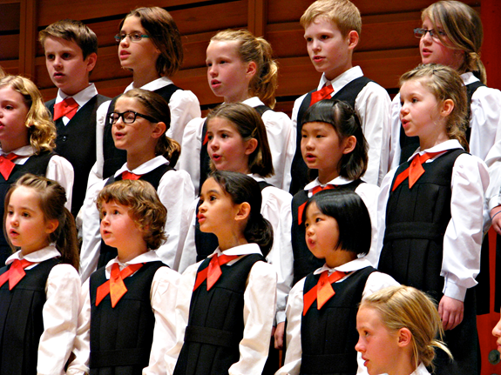
Importance of Arts Education
21st Century Learning Skills
College and career readiness
Helps close the achievement gap
Emotional & social learning
Prepared to succeed in our diverse society
Arts education is an essential part of a complete and competitive education for all Illinois students

Slide 3
Illinois: Increasing Access to Quality Arts Learning
1. Updating the Illinois arts learning standards
2. Equipping educators to use the standards effectively
3. Illinois & ESSA: Arts as an indicator of school quality
4. Illinois ESSA Arts Work Group to develop the measure
5. Illinois’ new “Arts & Communication” Endorsement
Having the arts at the table: Arts-
infused strengthening of K-12
education

Slide 4
Updating Illinois’ Arts Learning Standards
PHASE 1 (Dec 2014-Feb 2015)
Gathered initial input
Led by educators – Steering & Advisory Committees, 6 work groups
Statewide and diverse
4 phases. 34 meetings (16 all-day). >1,400 combined volunteer hours
Transparency & consensus
Extensive outreach: forums & surveys
Quality assurance: 11 reviewers
PHASE 2 (Feb-Sept)
Built consensus
PHASE 3 (Sept-Nov)
Engaged wider community
PHASE 4 (Nov 2015-May 2016)
Finalized Standards, Expanded support

Slide 5
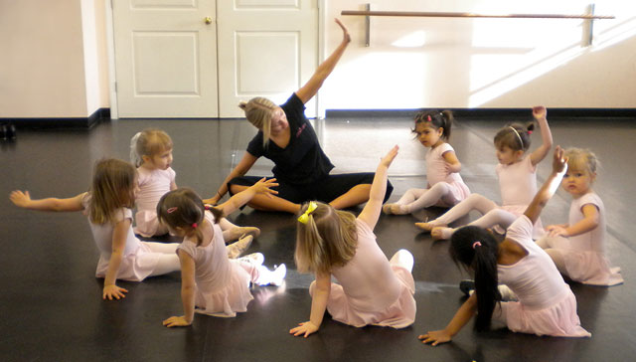
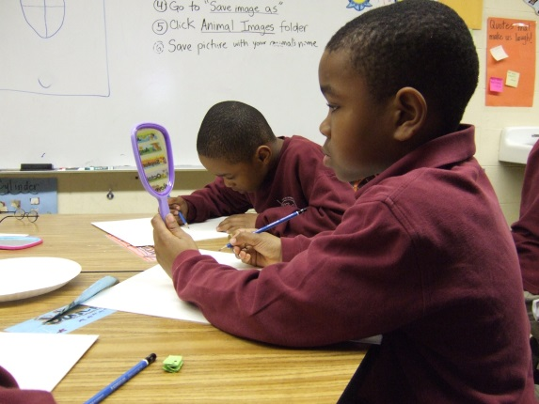
Differences Between Illinois & NCAS
Reworded two anchor standards
#3 – “Revise, refine, & complete artistic work”
#8 – From “Interpret intent” to
“Construct meaningful interpretations”
Changed the names of two high school levels
Proficient -> Introductory
Accomplished -> Intermediate
(Advanced stays the same)
Music “Strands” – 5 into 1

Slide 6
Teacher Resource: IllinoisArtsLearning.org

Slide 7
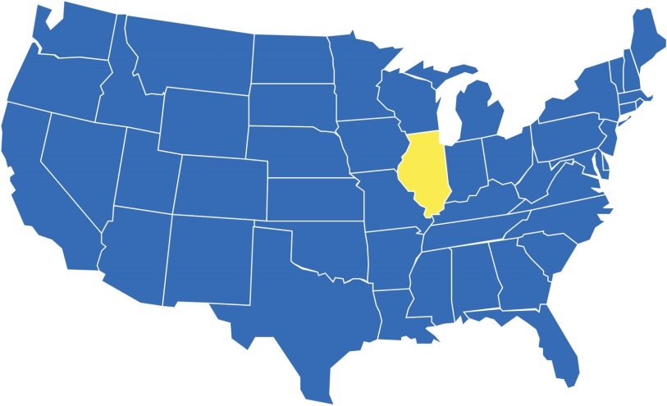
Illinois – ESSA Case Study
Bringing diverse
stakeholders to
the table
Process based upon
clear goals and
shared vision
A distinct indicator of school quality
Elementary & High School
A case study still in progress…

Slide 8
Illinois School Accountability System
Category | Elementary | High School
Core Academic Indicators (Total = 75%) | ELA Proficiency – 10% (7.5% starts ‘19/20) | ELA Proficiency – 10% (7.5% starts ‘19/20)
 | Math Proficiency – 10% (7.5% start ‘19/20) | Math Proficiency – 10% (7.5% start ‘19/20)
 | Science Proficiency – 0% (5% starts ‘19/20) | Science Proficiency – 0% (5% starts ‘19/20)
 | ELA & Math Growth – 50% | Graduation/ELA & Math Growth – 50%
 | English Learner Proficiency – 5% | English Learner Proficiency – 5%
School Quality Indicators (Total = 25%) | Chronic Absenteeism – 10% | Chronic Absenteeism – 7.5%
 | Climate Surveys – 5% | Climate Surveys – 5%
 | P-2 Indicator – 5% | 9th Grade On-Track – 6.25%
 | Elementary/Middle Grade Indicator – 5% | College & Career Readiness – 6.25%
 | Fine Arts Indicator – 0% (weight when measure) & data collection | Fine Arts Indicator – 0% (weight when measure) & data collection

Slide 9
ESSA Arts Indicator – Illinois Process
Illinois ESSA Arts Indicator Work Group
Establishing shared principles
Data & Research Team
Key data considerations
Community outreach & engagement

Slide 10
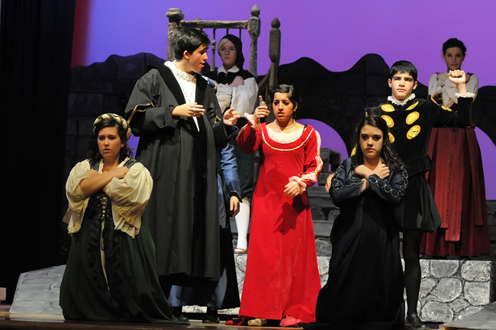
Arts & Communication Endorsement
Illinois Postsecondary & Workforce
Readiness Act
College & Career Pathway
Endorsement
7 sectors, including Arts &
Communication
Public-private steering committee
to develop competency
statements

Slide 11
Thank you!
Feel free to contact us:
Dr. Jason Helfer
Deputy Superintendent for Teaching & Learning
Illinois State Board of Education
jhelfer@isbe.net
Jonathan VanderBrug
Policy & Research Director
Arts Alliance Illinois
vanderbrug@artsalliance.org
312-855-3105 x 12

