Slide 1
Washington’s Approach to Expanding Pathways to Postsecondary Credentials
Presentation at the Education Commission of the States
December 5-6
Maddy Thompson, Executive Policy Advisor,
Office of the Governor
Mike Meotti, Executive Director,
Washington Student Achievement Council
Notes:
Today we’d like to provide some insights into the Washington state approach to meeting our population’s and our economy’s needs for individuals with postsecondary credentials
I will talk a little about where we have been, providing context and review some of our major developments
Mike Meotti, the Executive Director of the Washington Student Achievement Council,
will focus on where we intend to go in terms of regional efforts and targeting returning adult students
Self-intro: As an advisor to the Governor, I bring education and higher education stakeholders together to identify problems in our education and higher education systems and devise state-level strategies to help solve them…I work with our state legislators if we need to see changes in state statute, or additional investments
Before I worked for Governor Inslee, I worked in both the legislative and executive branches mainly on education and higher education issues,
and years prior I worked as a member of faculty at the University of Technology in Sydney Australia where I developed curricula for the multinational workforce at the Asia Pacific Headquarters of American Express and I also taught immigrants and refugees, among other assignments

Slide 2
Needs for Qualified Workers are Acute
The Washington Roundtable projected 740,000 job openings by 2021
Washington supply is falling short by at least 17,000 qualified individuals each year at the mid-education and baccalaureate levels: “A Skilled and Educated Workforce.”
State Postsecondary Goal:
70% of the population aged 25-44 will have a postsecondary credential (degree, certificate or apprenticeship) by 2023
Notes:
We have a history of planning to meet workforce needs in Washington with direction in statute that goes beyond federal requirements to plan for meeting workforce needs and evaluate the results
….However, support for these strategies ebbs and flows depending on economic cycle and perceived acuity of need
But establishing priorities and a north star is a very useful exercise in good times and bad.
For context we have a population of over 7.5 million with over 6 million in urban areas and about 1.2 million in rural areas; 76% of our population growth is due to in-migration and we import both highly skilled and low-skilled workers
we have a population aged 25-44 of about 2 million, and we have about 500,000 students enrolled in our public higher education system that includes 34 community and technical colleges and 6 public baccalaureate institutions, we also have a number of independent higher education institutions and other private career school providers
With that in mind – we have set a goal that 70 percent of our population aged 25-44 should have a postsecondary credential to meet our future workforce needs: We moved from 50 percent to 56% over a 4 year period since the goals were developed
Key Results At the mid-level,* out of 43,000 annual openings, projections show the supply of skilled graduates will fall short by almost 10,000 each year. The largest gaps are in computer and information science, technician, service, and education occupations. Mid-level demand in computer and information science is led by jobs for computer support specialists, software programmers, systems analysts, and web developers. Jobs for technicians are primarily in the fields of biology, life, physical, and social sciences. Teacher assistants, preschool teachers, and library technicians are key occupations driving demand for educators at the mid-level. As seen in previous analyses, demand also remains strong for specific health occupations, led by jobs for registered nurses; nursing, psychiatric, and home health aides; medical and dental assistants; diagnostic-related technologists; dental hygienists; massage therapists; and health practitioner support technicians. At the baccalaureate level, out of 33,000 annual openings, projections show that the supply of skilled graduates will fall short of meeting this demand by almost 7,000 each year. Overall degree-completions in computer science, engineering, health, and other STEM fields have increased substantially from 2007 to 2017. However, these gains were marked by uneven progress, rising steadily and peaking in 2012, but then followed by successive years of moderate decline. Consistent with previous reports on education and the workforce in Washington, the largest supply and demand gap at the baccalaureate level is in computer science and information technology, with the majority of jobs going to software developers, programmers, and systems analysts. Skilled workers in engineering are also in high demand, particularly in the area of civil engineering. The prominence of these two fields reflects the key role that technology and innovation play in fueling the state’s dynamic economic engine. Education is another occupational field at the bachelor’s degree level in which demand is currently outpacing the supply of qualified people to fill job openings. Demand is strong across a wide range of occupations: preschool and kindergarten, elementary and middle school, secondary school, and special education teachers. At the graduate and professional level, the largest gaps are in computer science and health occupations. In the top group, job openings are led by those for software developers, computer programmers, and systems analysts. In the health professions, strong demand is led by projected openings for physicians, surgeons, physical therapists, dentists, and pharmacists, and for advanced practice registered nurses, physical and occupational therapists, and medical technicians. K-12 education is an emerging high demand field at all education levels—middle, baccalaureate and graduate—driven by pressures for class-size reductions, teachers leaving the profession, and declining teacher program enrollments and completions. The key occupations driving demand for educators at the mid-level include teacher assistants, preschool teachers, and librarians. At the baccalaureate and graduate levels, demand is led by job openings for kindergarten, elementary, middle school, and special education teachers.

Slide 3
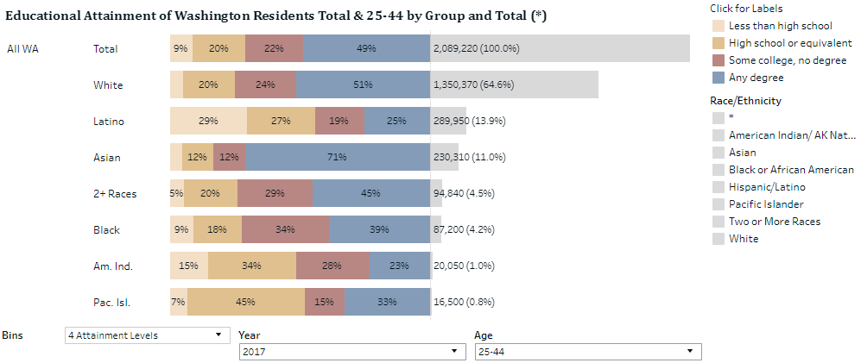
Opportunity Shouldn’t be Defined by Race/Ethnicity
Source: Washington Student Achievement Council, “Roadmap Dashboard” 2019: Interactive web tool to view educational outcomes in Washington State.

Slide 4
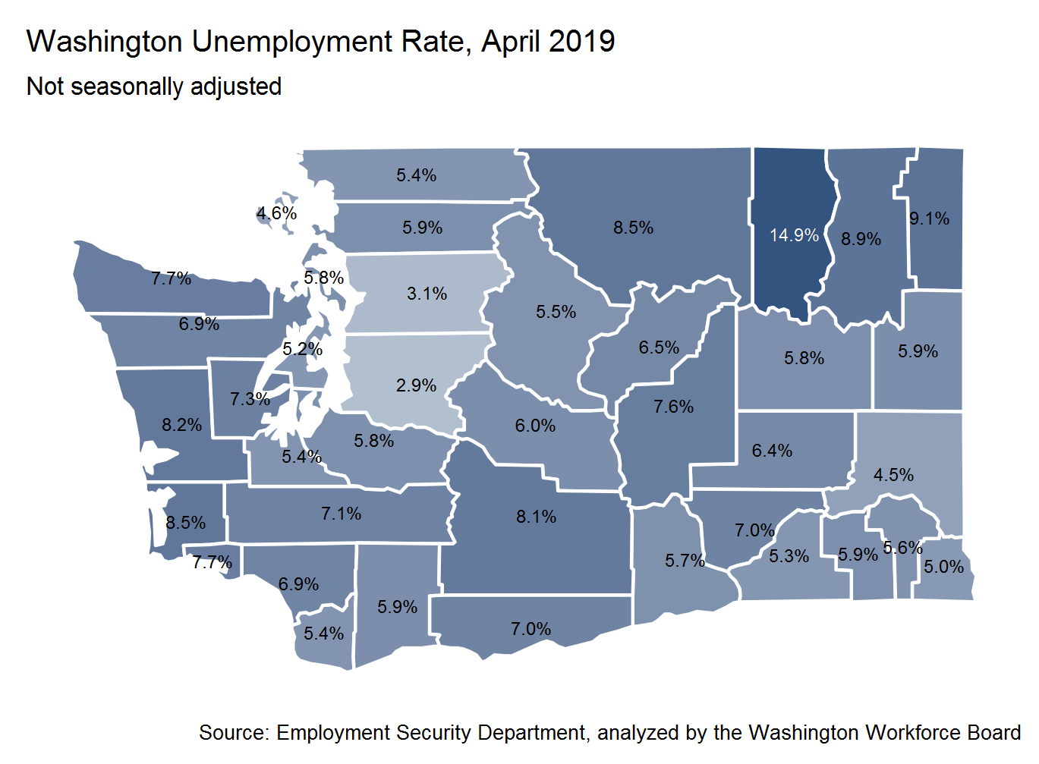
Rural/Urban Divide
Opportunity Shouldn’t be Defined by ZIP Code
Washington is thriving … but not everywhere.
How do we create environments where everyone can innovate and invent?
Access to innovation is key.

Slide 5
Major Advancements in 2019
HB 2158 created a dedicated workforce investment account and directed major higher education investments
Established the Washington College Grant
Established Career Connect Washington
Funded the Guided Pathways initiative to increase college completion
Required that students be eligible for Working Connections child care
Funded additional investments through a surcharge on certain service industries through the B&O tax
HB 1599 established multiple pathways to graduate
Ensured that students have options for college credit, career and technical completion sequences, military and other pathways recognized for the purposes of graduation

Slide 6
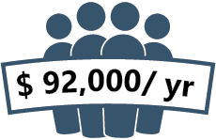
2019 Legislation: The Washington College Grant
In addition to tuition and fees the grant can cover other costs such as books and housing
GUARANTEED
FINANCIAL AID
BY ACADEMIC YEAR
2020-21
PREDICTED
TO SERVE A TOTAL OF
110,000
Students in the first year of implementation
Decreases debt
FREE
TUITION & FEES
FOR LOWEST INCOME
($50,000 FOR A FAMILY OF 4)
PARTIAL
TUITION & FEES
FOR LOW INCOME
($92,000 FOR A FAMILY OF 4)
Improves student success & completion

Slide 7
Career launch programs: Positioning young adults for promising careers
overall_1_131696877956906059 columns_4_131696877956504982 4_1_131723700746069344 5_0_131696877946819160 6_0_131696877947054791 7_0_131696877947340565 8_0_131696877947696516 11_0_131696877947826862 14_0_131696877947917101 17_0_131696877948052446 22_0_131696877948438483 97_0_131698588605729586 88_0_131700569165595600 91_0_131700567334764757 100_0_131700567334794854 85_0_131700567716065222 112_0_131700569165625998 109_0_131700569165646070
94_84 112_84 118_84 123_84 128_84
Meaningful, high quality on-the-job experience
Valuable credential beyond high school diploma
Aligned classroom learning
Competitive candidate
☑
At worksite
Paid and academic credit
Occupation-aligned
Employer supervisor at ratio typical of occupation
Defined competencies and skills gained
Full compliance with legal regulations
Curriculum and program requirements developed in partnership with employers and industry
Aligned with academic and employer standards
Qualified instructors
Dedicated student support (academic and career)
☑
☑
☑
Able to continue in employment OR successfully compete for jobs leading to financially sustaining and fulfilling careers
Credential attained OR
Significant progress (at least one year) toward a 2- or 4-year credential
☑
☑
☑
☑
☑
☑
☑
☑
☑

Slide 8
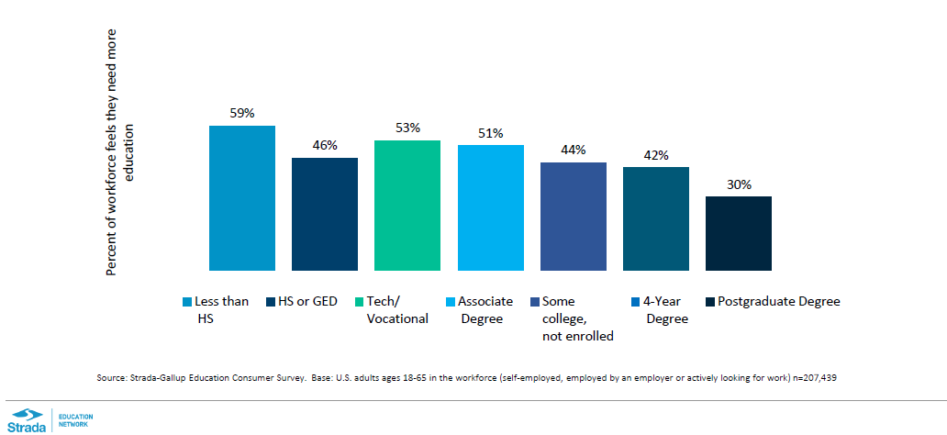
More Education Needed to Meet Worker and Employer Needs
Nearly half the workforce feels the need for additional education to advance in their careers

Slide 9
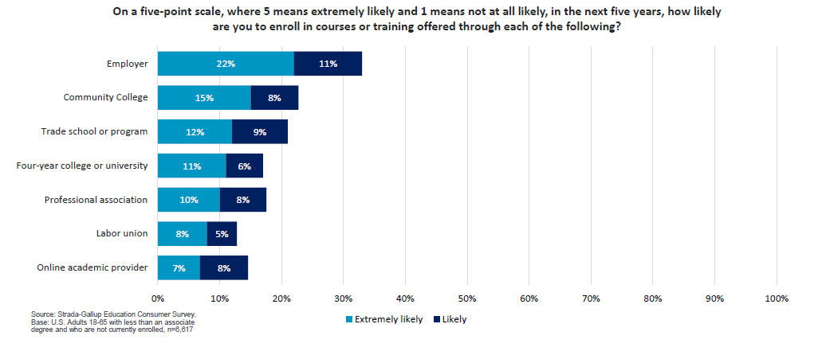
Adults without degrees most likely to seek education with employers

Slide 10
“Amazon Commits $700 million to Train U.S. Workers for a High-Tech Future”
The Seattle Times, July 11, 2019
“While many of our employees want to build their careers here, for others it might be a stepping stone to different aspirations.” Beth Galetti, senior VP of worldwide human resources, Amazon
The broader societal fear about job loss due to automation represents a long-term risk to the company, commented Tom Forte of D.A. Davidson. “Working in Amazon’s favor is the company’s ability to (1) create job growth, internally and (2) training its own employees to be able to embrace whatever the future may hold for jobs both within and outside of Amazon.”
“In 2014, Starbucks began a partnership with Arizona State University to offer discounted tuition and subsidies to employees as an incentive to earn a degree online and retain workers.” Benjamin Romano, Seattle Times reporter

Slide 11
How Responsive is Our Education and Training System?
Regional needs
Natural disasters/ climate change
Economic cycles
Education & Training System
Political climate
International trade & politics
Demographic changes
Technology & AI development
Labor market
Notes:
Our postsecondary education system doesn’t exist in a vacuum, it has to be responsive to changes that are larger than the system itself – such as the economy. When we have a book, students in our community and technical college system often drop out of their program to take advantage of new job opportunities and then we see declined in enrollment.

